Slide 1
NHSE elearning author guide
This session offers guidance on writing content for NHSE elearning programmes.
Select a chapter to begin.
Introduction
Planning your session
Creating your content
Supporting the development process

Slide 2
Resources
Websites
Elearning heroes. All About Learning Objectives for E-Learning. View website
Shift elearning. Writing for elearning. View website
Elearning Industry. 5 ways to create engaging elearning content. View website
Talk LMS. How to create elearning content learners will love. View website
NHSE Guidance
NHS Content Guide. Standard for creating health content View website
NHS Content Guide. Inclusive content. View website
NHS Digital Service Manual. Accessibility. Guidance for content . View website
NHSE Readability tool. View website
Documents
NHSE TEL. Session plan example.
NHSE TEL. Content document example.
NHSE TEL. Content plan example.
NHSE TEL. Writing questions for formal assessments.
NHSE TEL. Animation script writing guidelines.
References
1| A Quick Guide to Referencing | Cite Your Sources Correctly (scribbr.co.uk)
Author
This session was created by the NHSE Technology Enhanced Learning Content Development Team
Notes:
drawer icon

Slide 3
Introduction (text/graphic/accordion)
Good content is essential for the success of an elearning session.
Writing good content is about more than correct spelling and proper grammar. It’s about engaging your learner and ensuring they can spend less time interpreting content and more time retaining knowledge.
This session is designed to guide you through the authoring process and advises on how to write content that will engage and motivate learners.
Select the headings for more information about this session and how to use it.
+ Session information
+ Learning objectives
+ Navigation instructions

Slide 4
How will this session help me?
By the end of this session, you will be able to:
discuss the considerations for producing engaging and NHSE-compliant elearning content
create a session plan
submit structured and outcome-focussed content for development
identify your role and responsibilities within the ongoing session development process
How do I use this session
Select the:
home icon to return to the menu
drawer icon for more project information, access links to useful resources or to use the search function
eye icon to reveal the dyslexia overlays
exit icon to exit the session
To exit the session via ESR select the: home icon at the top right of the window.
Track your progress through the chapters by selecting the grey progress bar at the top of the session window.
How long will this session take to complete?
This session will take approximately 20 minutes to complete.
You may find it helpful to bookmark the link to this session so you can refer back to it and/or the additional resources it provides.

Slide 5
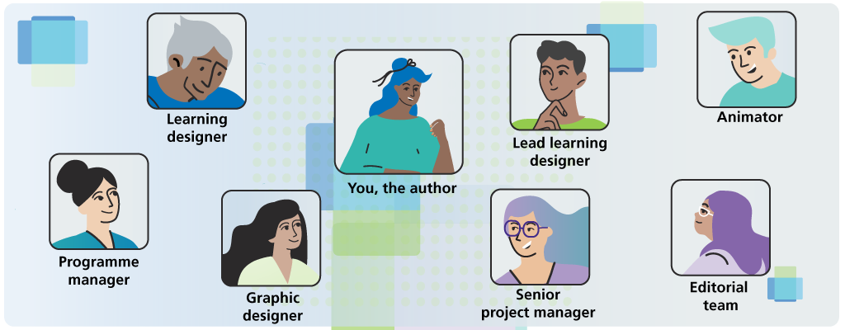
Meet your team (hot graphic)
This session was written and developed by the NHS England Technology Enhanced Learning (NHSE TEL) Team, who will advise and support you, and your clinical or project lead, through the process of creating your elearning session.
Select the pin icons to find out more about the people who will help you turn your ideas into reality and your role within the team.

Slide 6
Meet your team (hot graphic)
You, the author
It is your role as an author to write the initial content and then collaborate the NHSE TEL team to develop the finished session.
PGM
LLD
SPM
Author
LD
GD
AD
ED

Slide 7
Meet your team (hot graphic)
Programme manager (PGM)
The PGM has overall responsibility for the NHSE TEL project team and works with your clinical or project lead to ensure that the project is delivered to time and budget.
PGM
LLD
PGM image
SPM
Author
LD
GD
AD
ED

Slide 8
Meet your team (hot graphic)
Senior project manager (SPM)
The SPM coordinates the other members of the team and works with your clinical or project lead and any other stakeholders (for example, editors, reviewers, working groups) to ensure your session is delivered in scope and on time.
PGM
LLD
SPM image
SPM
Author
LD
GD
Hotspot graphic placeholder 1024 x ?
AD
ED

Slide 9
Meet your team (hot graphic)
Lead learning designer (LLD)
The LLD is responsible for developing the right creative and learning design approach for your session.
They will support you and other team members to apply this throughout the development process.
PGM
LLD
LLD image
SPM
Author
LD
GD
AD
ED

Slide 10
Meet your team (hot graphic)
Learning designer (LD)
The LD will work with you collaboratively to design and build your session.
They will advise on any changes that need to made to comply with NHSE editorial standards and use learning design theories enhance your learners' engagement and knowledge retention.
PGM
LLD
LD
image
SPM
Author
LD
GD
AD
ED

Slide 11
Meet your team (hot graphic)
Graphic designer (GD)
The GD works with you and the team to design how the session will look and create any images needed.
PGM
LLD
GD
image
SPM
Author
LD
GD
AD
ED

Slide 12
Meet your team (hot graphic)
Animator
An animator may be assigned to work with you on your session(s) if there is an animation requirement.
Animators work collaboratively with you to understand what you need, offering advice and guidance on story boarding and scriptwriting in order to develop the animation for the project.
PGM
LLD
LD
image
SPM
Author
LD
GD
AD
ED

Slide 13
Meet your team (hot graphic)
Editorial team
The editorial team review each session to ensure it meets NHSE TEL editorial standards and accessibility requirements.
PGM
LLD
ED
image
SPM
Author
LD
GD
AD
ED

Slide 14
The ‘secrets’ of success (MCQ)
The NHSE TEL team were asked for their top tips to help authors to create good content.
Which of the following tips do you think they included?
Choose all the correct options then select Submit.
Understand who the learner is and why they are doing the elearning
Have defined and measurable learning objectives
Consider ways to encourage learner engagement and motivation
Write in a structured and objective-focused way
Use a clear, concise and direct writing style
Including opportunities for the learner to pause and reflect
Graphic placeholder
512 x 400

Slide 15
Feedback
The NHSE TEL team consider all of the following as essential for writing good content for elearning:
understand who the learner is and why they are doing the elearning
have defined and measurable learning objectives
consider ways to encourage learner engagement and motivation
write in a structured and objective-focused way
use a clear, concise and direct writing style
include opportunities for the learner to pause and reflect
We will discuss each point in more detail in the session.

Slide 16
You have now reached the end of this chapter.
Select the arrow icon to continue to the next chapter which offers guidance on planning your elearning session.
Select the home icon to return to the menu.
To exit the session, select the exit icon.

Slide 17
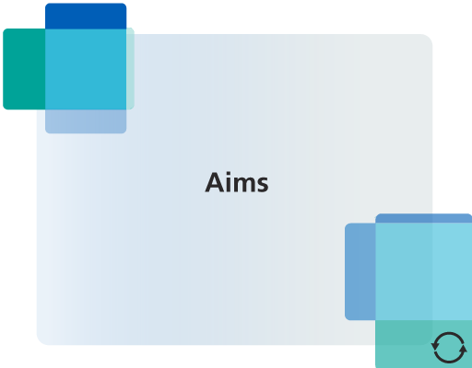
Planning is key (flip cards x4)
As with all projects, planning is key.
Certain factors need to be considered when planning an elearning session as they can influence how you write your session, how long it will take to complete, and the budget required.
Select the images to find out what these factors are.
Aims
Audience

Slide 18
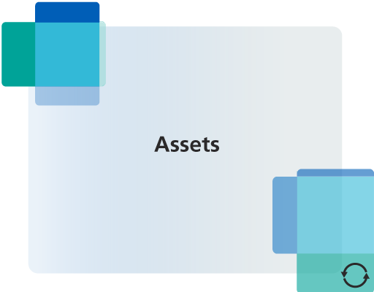
Learning objectives
Assets

Slide 19
Aims
Consider:
why have you been asked to write this content
what knowledge gaps it is intended to fill
will it stand alone or is it part of a blended learning programme
if formal assessment is required.
Audience
Consider:
who you are writing your elearning for
why they need to do this learning
what they know already
how and/or where they will access the learning
Learning objectives
Identify what your learning objectives are.
Learning objectives define what learners should be able to do by the end of a learning experience.
Select the drawer icon for guidance on writing learning objectives.
Assets
Consider whether you want to include video, animation and/or audio assets in your session.
If the assets are available, familiarise yourself with the scripts before you write your content.
If the assets need to be created, write the scripts at the same time as your content.

Slide 20
The boundaries of best practice (Conversation)
Another aspect to consider when planning an elearning session is understanding the medium's strengths and limitations.
Select the arrow icon to reveal the key points of elearning best practice.
1 of 3: Present the key points
elearning communicates the key learning points of a topic in a way that can be easily retained.
Think of key learning points as the study notes a student would take in a lecture or from a textbook when revising.
You can signpost learners to sources of more detailed information and encourage then to find out more.
Conversation background
1024 x 400
>
>

Slide 21
2 of 3: Less is more
Be concise and to the point, use as few words as possible.
If you include too much detail or too much content your learner will spend more time interpreting content and less time retaining knowledge.
3 of 3: Know your limits
To support maximum learner engagement and knowledge retention, NHSE TEL elearning sessions should include a maximum of:
3500 to 4500 words
4 to 5 learning objectives
If you can’t cover what you need to within these limits, consider the need for multiple sessions.

Slide 22
Create a session plan (text/reveal)
>
When you are clear about what you want to achieve in your session, document the details in a session plan.
Select the hyperlink to download the plan for this session. You can use this as a template for your own.
Select the arrow to reveal some tips from learning designers to help you complete your session plan.
Session plan icon Reveal graphic
512 x 400
Before you start writing your content, your session plan should be reviewed and signed off by your clinical or project lead.
It should then be submitted to the NHSE TEL team, who may request clarification or amendment of some of the details.

Slide 23
>
AI tools like Chat GPT and Google assist and and Microsoft Copilot can help you:
define learning objectives
identify key topics and key points
collate lists of further reading resources and websites which support the information in your session

Slide 24
Key points (Fill the blanks)
You have now reached the end of this chapter.
Let's recap on the key points to remember when planning your elearning session.
Choose true or false for each statement from the drop-down lists, then select Submit.
The purpose, aims and audience for your session will influence how you write your content (T)
Identify your learning objectives, you can have a maximum of 4 to 5 in a session (T)
elearning sessions should only communicate the key learning points of a topic (T)
Your session should include a maximum of 3500 to 4500 words (T)
Fill in a session plan document and ensure it is signed off before writing your content (T)

Slide 25
Less is more (Fill the blanks. Drop down)
Feedback
The key points to remember when planning an learning session are:
consider the purpose, aims, assets and audience for your session, these factors will influence how you write your content
identify your learning objectives, include a maximum of 4 to 5. If you think you will need more, you will need more sessions
elearning should only communicate the key learning points of a topic
a session can include a maximum of 3500 to 4500 words. If you think you will need more, you will need more sessions
complete a session plan document and ensure it is signed off by your clinical or project lead and the NHSE TEL team before you write you content
Yes/No
512 x 400

Slide 26
Select the arrow icon to continue to the next chapter which offers guidance on creating the content for your elearning session.
Select the home icon to return to the menu.
To exit the session, select the exit icon.

Slide 27
The 3 golden rules
Before you begin creating your content, it is important to understand that how you write is as important as what your write.
NHSE TEL have editorial standards with which all sessions must comply. You are not expected to be familiar with these, the team will make the required changes to your content during the development process.
There are however, 3 golden rules you must follow when creating your content.
Graphic placeholder
512 x 400

Slide 28
Select the arrow icons to find out more about the 3 golden rules for writing elearning content.
Be accessible
Be inclusive
Be engaging

Slide 29
Be accessible
Accessible writing means making sure all users can read and understand what you write, including users with different mental and physical abilities.
To write in accessible way:
use plain English, avoid jargon and complex sentences
aim for clarity and simplicity
use as few words as possible
provide alterative text to describe important images for those who use screen readers (for example: graphs, flow diagrams, text-heavy images)
Select the drawer icon for more guidance on NHS accessibly requirements and tools to help you with readabilty.
Be inclusive
Inclusive language respects and promotes all people as valued members of society. It uses vocabulary that avoids exclusion, stereotyping, sexism, racism any other forms of discrimination.
To be inclusive:
write for a diverse audience and make reflect that diversity in text and images
avoid referring to a person’s race, gender, sexual orientation, disability, or age, unless those descriptors are relevant to the story
avoid conscious and unconscious biases. For example, avoid masculine pronouns or nouns for mixed-gender groups, or defaulting to ‘he/him’ when a person’s gender is unknown or unclear
Select the drawer icon for more guidance on creating inclusive content.

Slide 30
Be engaging
Writing in a way which engages and motivates your leaner will result in a higher level of knowledge retention.
To engage your learners:
be direct: get to the point quickly and keep content focused on the learning objectives
use an active voice (where your subject performs the action) rather than a passive voice (where your subject receives the action)
break up your content with knowledge checks and/or activities to reinforce learning providing constructive feedback
incorporate stories and/or case studies into your content to add context and make your content relatable and memorable
use images to support key learning points
Select the drawer icon for more guidance on writing engaging content.

Slide 31
The 6-step process
Knowing where to start when writing content is often the biggest hurdle.
When you created your session plan, you did most of the hard work and you can now build on this to create the content of your session by following a simple 6-step process
Select the arrow icons to follow the 6-step process.
1 of 6: Introduce your session
Begin your content with an introduction outlining the purpose and aims of your session. This should be 1 to 2 paragraphs long.
Use the introduction and learning objectives you have written in your session plan document as starting point. You not need to add anything else.
Graphic placeholder
512 x 400
>
>

Slide 32
2 of 6: Find the hook
After the introduction, include a hook.
A hook is something that encourages learners to engage with your session and makes them want to read on.
Think about who your learner is and what they want to achieve then begin your session by telling them how the session will help them reach this goal.
Present this as a scenario or an interactive exercise like a question or a click to reveal activity.
Graphic placeholder
512 x 400
>
>

Slide 33
3 of 6: Create a framework
Create a structure using the learning objectives and key points in your session plan:
approach each objective separately
create subheadings under each objective, based on the key topics identified in your session plan
You can now have a framework and can add relevant content beneath each subheading.
Chunking your content in this way makes information clearer and easier to remember.
Graphic placeholder
512 x 400
>
>

Slide 34
4 of 6: Build your content
Add content beneath each learning objective subheading in your framework.
Remember the 3 golden rules: be accessible, inclusive and engaging.
If you include facts and figures you must provide links to your sources to avoid plagiarism [1].
Add any ideas for images to support the text as you go, including descriptive text if required.
Images taken from the internet cannot be used without the relevant permissions but the NHSE TEL team can use these as reference material to create new ones for your session.
If you are including video or animation add placeholders and/or transcripts within your content. (If you will be writing a script select the drawer icon to download the NHSE TEL. Animation script writing guidance document.
Graphic placeholder
512 x 400
>
>

Slide 35
5 of 6: Summarise
When you have added all your content add a list of key learning points.
These should be single sentence ‘take away’ points you want learners to retain after completing the session.
Refer to the list you collated in your session plan as a starting point. You may not have to add any more.
Check that all your key points are covered in your content.
Graphic placeholder
512 x 400
>
>

Slide 36
6 of 6: Signpost
Finally, add a list of resources and websites to support the topics in your session so the learner knows where they can find more information and support.
Refer to the list of additional resources you have collated for your session plan as a starting point.
Graphic placeholder
512 x 400
>
>

Slide 37
Select the hyperlink to download the content created for this session as an example of what following the 6-step will produce.

Slide 38
Assessment questions (text/flipcard)
Assessment questions are only required if there needs to be a formal assessment included in your session.
Consider writing your assessment questions first as this could help you focus your main content.
Select the drawer icon more information on writing assessment questions.
Select the image for some quick tips.
Flip placeholder
512 x 400

Slide 39
Test the key learning points for each learning objective.
Only test knowledge that has been covered in your content.
Provide feedback for incorrect answers. This will be the last chance to correct any misunderstanding.
Use the same language and terminology in your questions as you have in your content.
Questions should not 'trick' or misdirect the learner.

Slide 40
Check your work (text/reveal)
When you have finished writing the content for your session, remember to check and review it against the guidance in this session.
Select the arrow icon to reveal the completed content checklist
>
Checklist Reveal placeholder
1024 x 400

Slide 41
>
When your content is complete, check:
spelling and grammar
your word count: 3500 to 4500 maximum
the content covers (and is limited to) the objectives and key topics in your session plan
you have used accessible, inclusive language and imagery throughout
you have included descriptive text for images which communicate learning points
you have included links to sources you have referenced
if included, your assessment questions do not test learning points not included in the session

Slide 42
Review and sign off (text/graphic)
When your content is complete it should be shared with your CL and/or PL and any other stakeholders in your project team for review and sign off.
When signed off as complete and correct, your content can be submitted to NHSE TEL. The content development process will then begin

Slide 43
Key points (Fill in the blanks)
You have now reached the end of this chapter.
Let's recap on the key points to remember when creating your elearning content.
What are the 3 golden rules you must follow when creating your content?
For each statement, select the correct word to complete the sentence from the dropdown list, then Submit.
Be %?%: keep your language simple and concise and understandable by all users
Be %?%: write for a diverse audience reflect that diversity in the language and images you use.
Be %?%:get to the point quickly, keep content focused on the learning objectives, use an active voice

Slide 44
Key points (Fill in the blanks)
Feedback
The 3 golden rules of writing content for elearning are:
Be accessible: keep your language simple and concise and understandable by all users.
Be inclusive: write for a diverse audience reflect that diversity in the language and images you use.
Be engaging: get to the point quickly, keep content focused on the learning objectives, use an active voice.

Slide 45
Select the arrow icon to review the other key points from this chapter.
Key points
Follow the 6-step process to help you create your content.
Break up your content with knowledge checks and/or activities to reinforce learning providing constructive feedback.
Incorporate stories and/or case studies into your content to add context and make your content relatable and memorable.
Make suggestions for images to support your learning points.
Provide placeholders, transcripts, links to any video and/or animations.
Provide links to all sources you reference.
If required, write assessment questions which reflect the key learning points.
Check your word count and your content for errors and omissions.
Your content should be reviewed and signed doff by your clinical or project lead before submission to NHSE TEL

Slide 46
Select the arrow icon to continue to the next chapter which describes the development process and your role within it.
Use the home icon to return to the menu.
To exit the session, use the exit icon.

Slide 47
Teamwork
Now that your content has been submitted to the NHSE TEL team, the development process can begin.
Your input as the author does not stop here. You are now an integral part of the team collaborating to create an elearning session from your vision and hard work.
Graphic placeholder
author as part of the team?
512 x 400

Slide 48
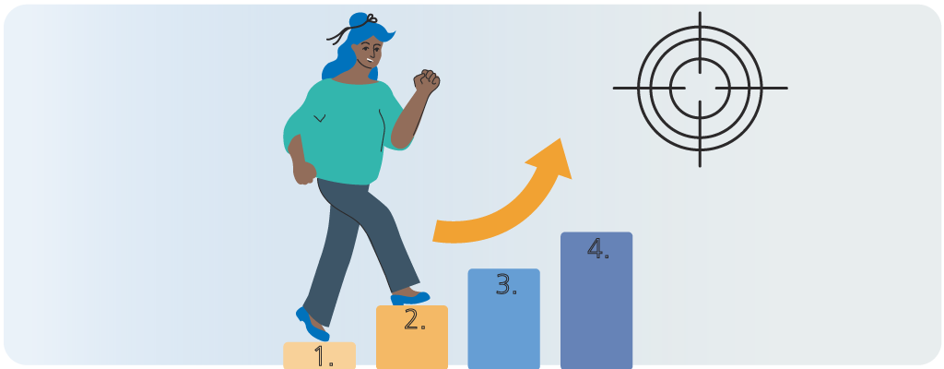
Your role in the development process ( text/graphic/accordian)
The development process consists of 4 phases.
You will have an important role to play throughout.

Slide 49
Select the arrow icons to find out more about each phase and your responsibilities in each.
1. Design
2. Build
3. Final review
4. Release

Slide 50
Design
What happens in the design phase?
The design phase involves the development of a content plan, a PowerPoint document which storyboards your session.
The content of a session will evolve during this process as the LD make changes to maximise engagement and retention. Edits will also be made to comply with NHSE editorial standards.
What is my role in the design phase?
To work collaboratively with a learning designer, graphic designer to create the content plan. Please respond to any questions as soon as you can, as delays can impact the delivery of the project.
When is the design phase complete?
When the content plan has been reviewed and signed off as complete and correct by you, your clinical or project lead and any wider stakeholder group involved.
Select the hyperlink to download the content plan for this session as an example.

Slide 51
2. Build
What happens in the build phase?
The build phase involves the development of a working prototype of your session.
What is my role?
You will work collaboratively with an LD to build the session who will provide you a link to view the session as it progresses.
Please respond to any questions as soon as you can as delays can impact the delivery of the project.
When is the build phase complete?
When the built session has been reviewed and signed off as complete and correct by you, your clinical or project lead and any wider stakeholder group involved.

Slide 52
3. Final review
What happens in the final review phase?
The NHSE editorial team will review against NHSE TEL editorial standards and accessibility requirements. The learning designer will then amend the session as necessary.
What is my role?
The LD may come back to you for guidance if the editorial review highlights clinical, or other content-related issues.
Please respond to any questions as soon as you can as delays can impact the delivery of the project.
When is the final review phase complete?
The final review phase is complete when the session fully complies with NHSE TEL editorial standards.

Slide 53
4. Release
What happens in the release phase?
Your session tested to ensure it works as it should before being released on the NHS Learning Hub.
What is my role?
At this stage, your responsibilities as the author have ended.
When is the release phase complete?
When the session is live on the NHS Learning Hub and communication messaging is released.

Slide 54
Key points (MCQ)
You have now reached the end of this chapter.
Let's recap on the key points of how you support the development process.
What are your responsibilities?
Choose the correct option, then select submit.
To collaborate with other members of the team to create a content plan and built session (t)
To ensure the content of the session does not change from what was signed off and submitted
To respond quickly to requests and queries from other team members at all stages of development (t)
To ensure the content of the session complies with NHSE TEL editorial standards
>
>

Slide 55
Key points (MCQ)
Feedback
Your role in the development process involves working collaboratively with other team members to design and build your session.
The content of a session will often evolve during the development process.
One of your most important responsibilities throughout the development process is to respond to requests and queries as soon as possible as delays can impact the delivery of the project.
You are not expected to be familiar with NHSE TEL editorial standards.
>
>

Slide 56
Select the drawer icon to access links to useful resources which can support you through the authoring process
Use the home icon to return to the menu.
To exit the session use the exit icon.

